Slide 1










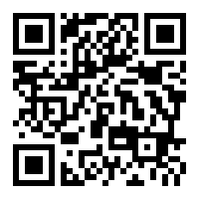
VISION
LIVE GREEN! INITIATIVES
works to encourage all
students including alumni and all faculties to be committed and be engaged in the effort of our school to be as ‘green’ as possible. We hold ambition to make ISU a leader in sustainability among land-grant institutions.
Find us here! #iowastate #livegreen
LIVE GREEN! INITIATIVES
OFFICE OF SUSTAINABILITY
Room 108 General Svcs
700 Wallace Rd
Ames, IA 50011-4013City
LIVEGREEN@IASTATE.EDU
Brochure subtitle or company tagline

Slide 2
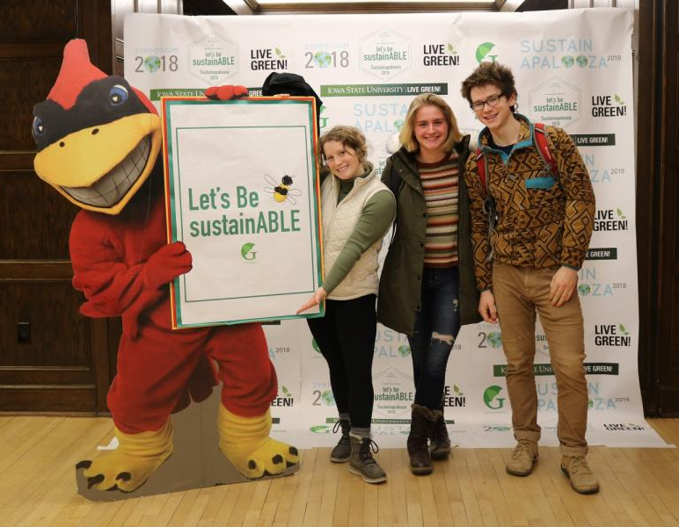









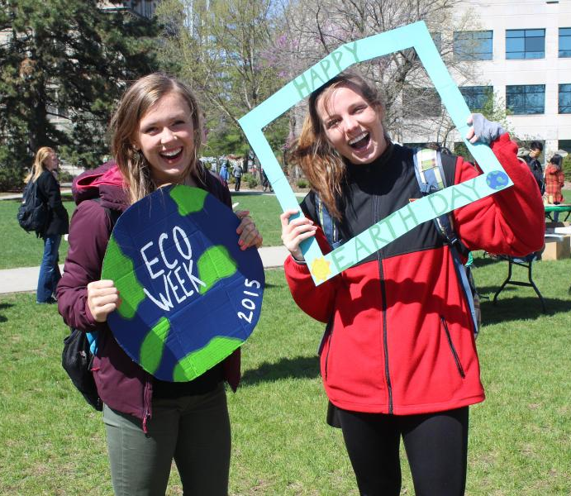





TEN WAYS TO LIVE GREEN
RESOURCES FOR YOUR
LIVE GREEN ADVENTURE…
Purchase with Purpose
STUDY GREEN
Look up Live Green! Sustainability course directory.
JOIN A GREEN CLUB
Search through student organization database!
LEARN WITH SUSTAINABLE FRIENDS
STAY IN THE GREEN KNOW
Keep connected with events and opportunities!
GIVE BACK AND PAY FORWARD
Be a volunteer!
Not around, Turn it Down
Green Your Ride
PAST EVENTS
Green Bag It
Maple Syrup Day
14 Apr 2018 8:00 am @ Iowa Arboretum, 1875 Peach Avenue, Madrid
Unplug the Unused
Lecture: Science Fiction Writing
17 Apr 2018 7:00 pm @ Great Hall, Memorial Union
Twist Your Lights
Make your Flow
Lecture: Sustainable Intensification of Agriculture
18 Apr 2018 7:00 pm @ Sun Room, Memorial Union
Bring your own Bottle
Earth Day Celebration
19 Apr 2018 11:00 am @ East Marston Lawn, near Parks Library
Power Down
Remember the 4 Rs

